Slide 1

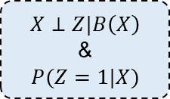


Main Logic Flowchart
Real advantages:
Unbiased estimator
Better statistical property
Randomized
(experiments)
Both useful for
causal inference
Nonrandomized
(observations)
Strongly ignorable condition
$$Z$$
?
$$R$$
Randomization itself do not directly result in “similarity”
Key point: two “similar” (comparable) groups? (handle the confounding variables)
$$X$$
handle the confounding variables
Pre-control
Post-control
Limited sample size multiple confounding variables
Another story
Step1: fit propensity score
Balancing score &
propensity score
Step2: Balance the sample
$$X⊥Z|B\left(X\right)$$
&
$$P(Z=1|X)$$

Slide 2
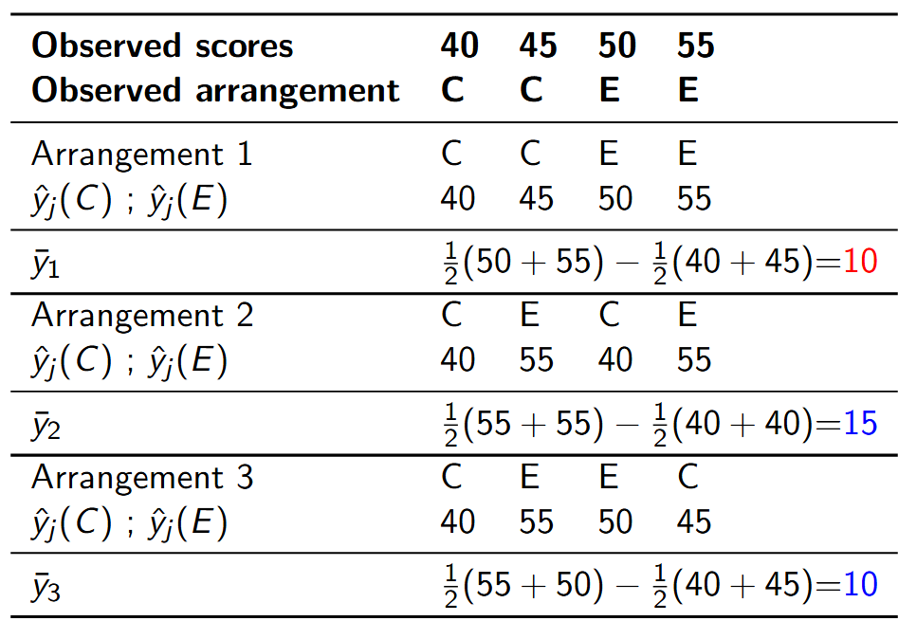
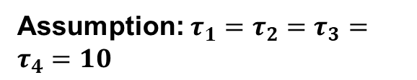
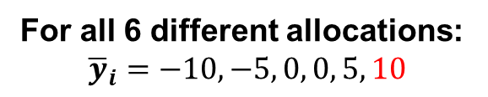
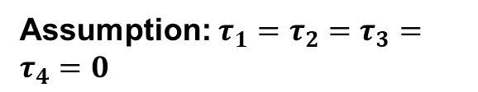
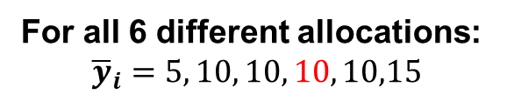
The Intuitive Causal Test of Paper (1974)
Assumption: $τ_{1}=τ_{2}=τ_{3}=τ_{4}=10$
For all 6 different allocations:
$${\overline{y}}_{i}=5, 10, 10, 10, 10,15$$
Assumption: $τ_{1}=τ_{2}=τ_{3}=τ_{4}=0$
For all 6 different allocations:
$${\overline{y}}_{i}=−10, −5, 0, 0, 5, 10$$

